Slide 1
/DISCORD
ACCESSIBILITY
TEAM 1F: DISCORD ACCESSIBILITY
WELCOMING AND SUPPORTING UNDERREPRESENTED VOICES

Slide 2
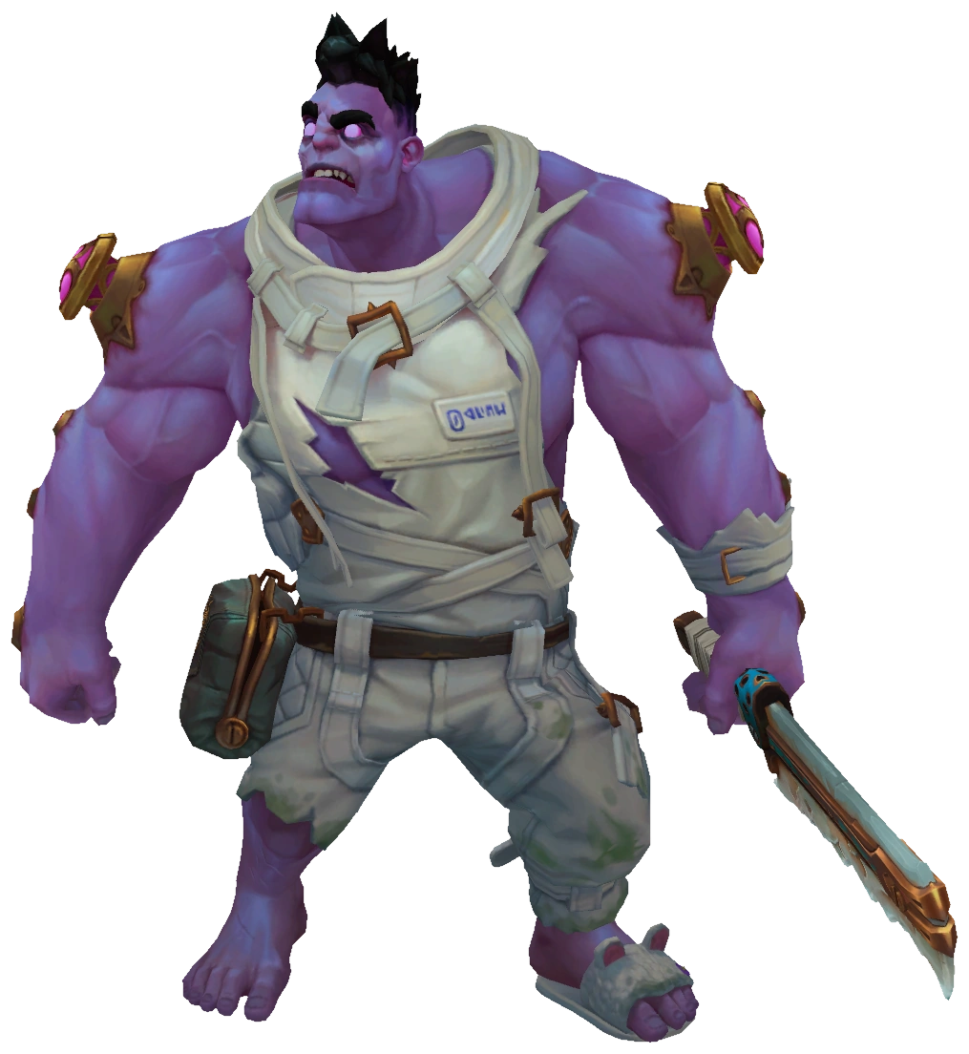
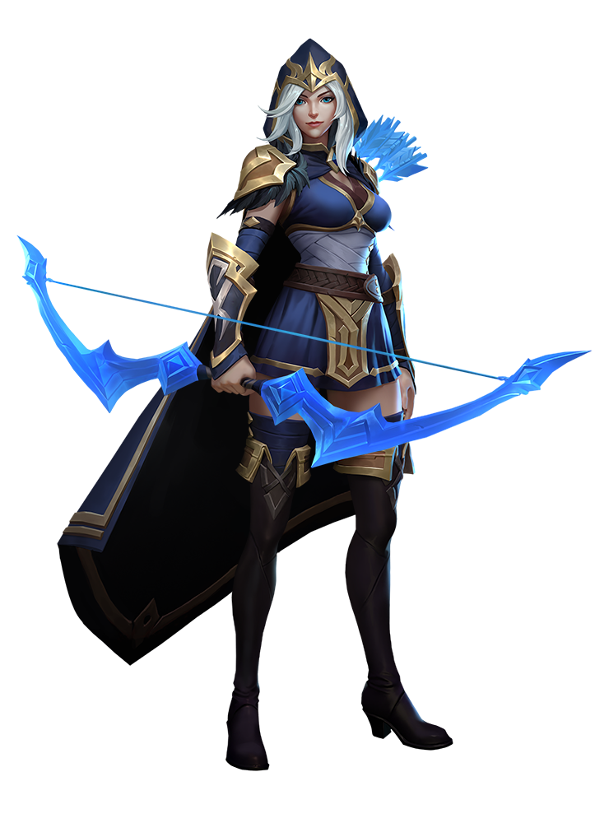
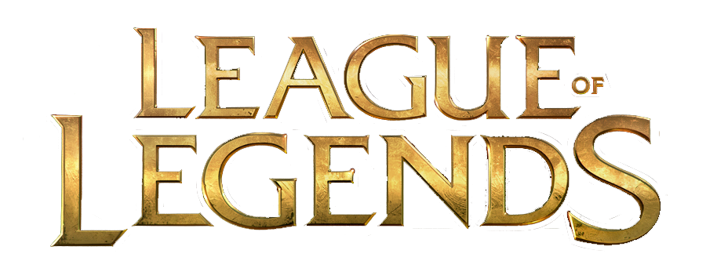
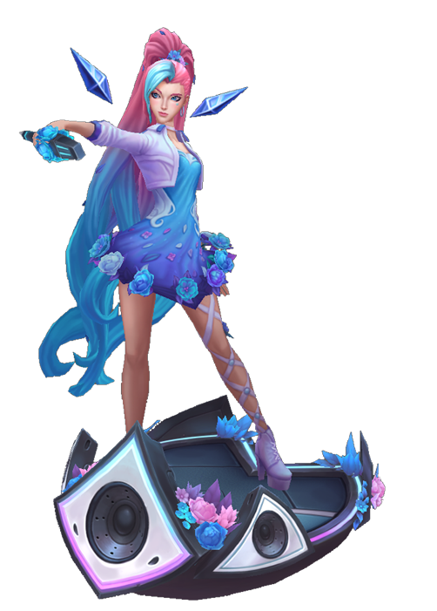
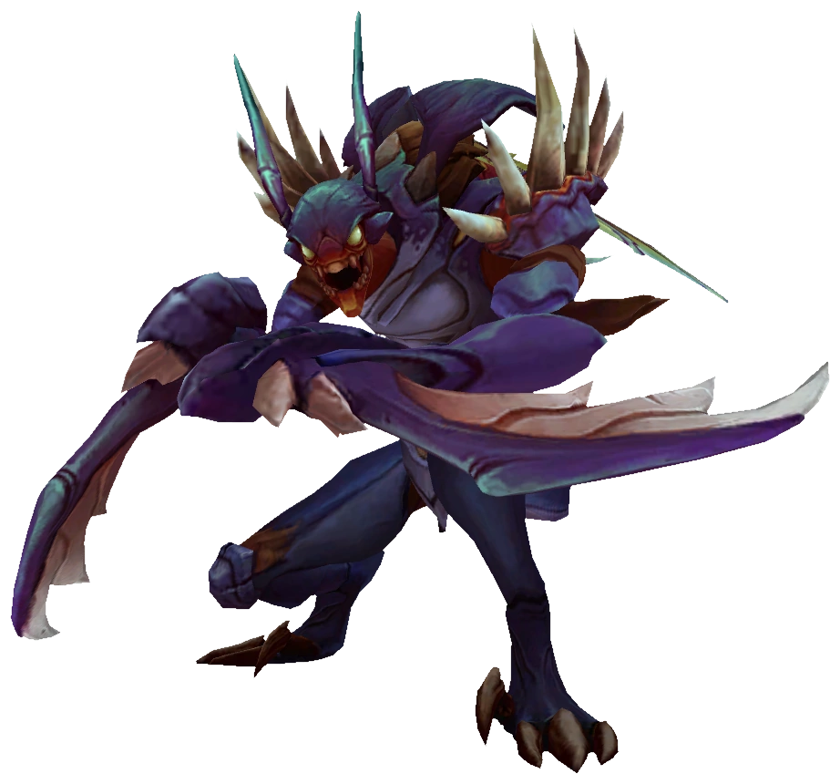
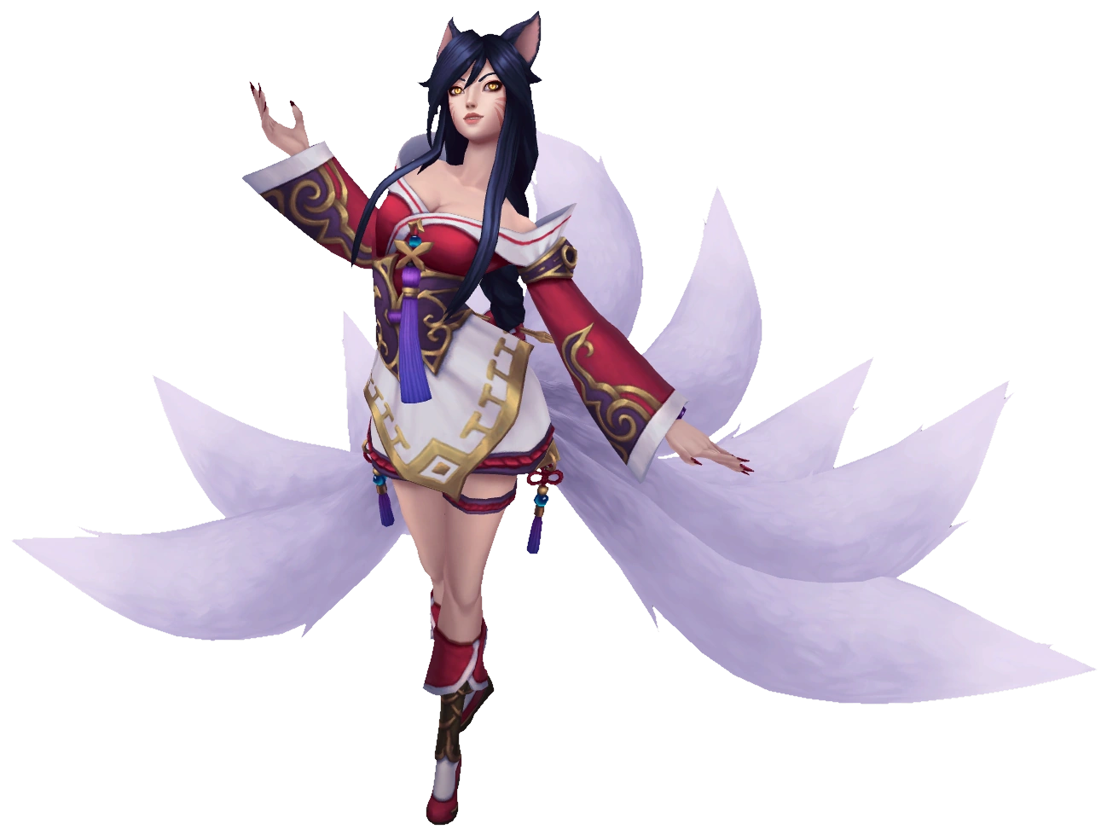
TEAM 1F: DISCORD ACCESSIBILITY
YOU
WELCOMING AND SUPPORTING UNDERREPRESENTED VOICES

Slide 3

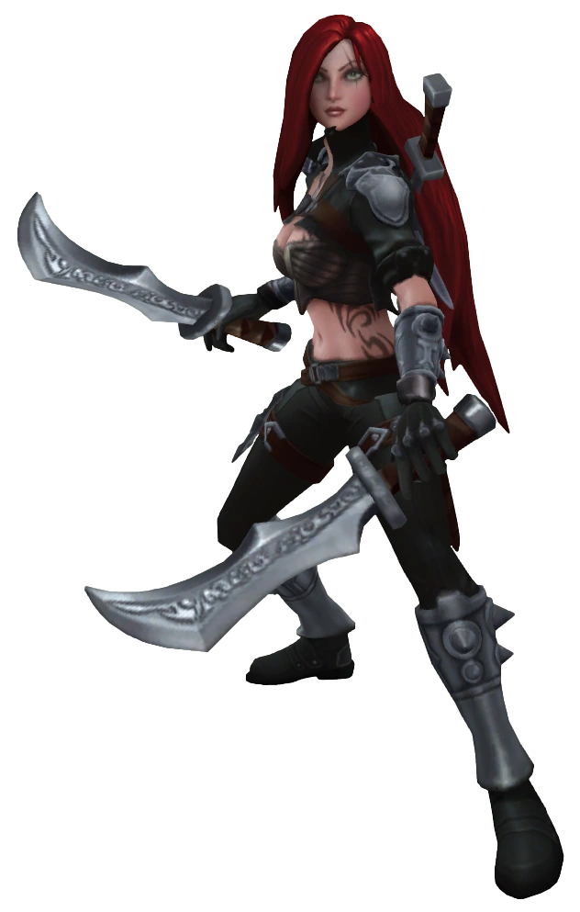
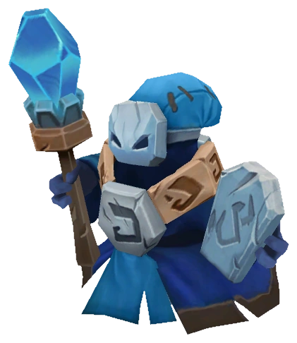
TEAM 1F: DISCORD ACCESSIBILITY
WELCOMING AND SUPPORTING UNDERREPRESENTED VOICES

Slide 4
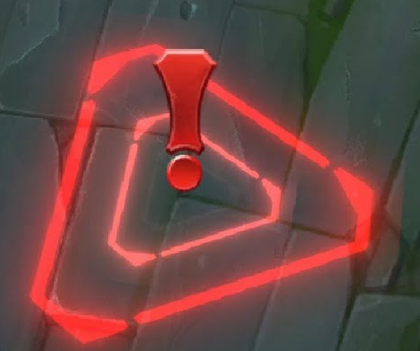

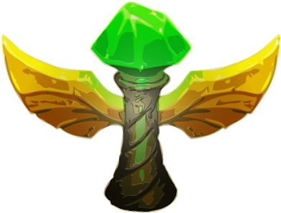
TEAM 1F: DISCORD ACCESSIBILITY
Dude, no
WELCOMING AND SUPPORTING UNDERREPRESENTED VOICES

Slide 5
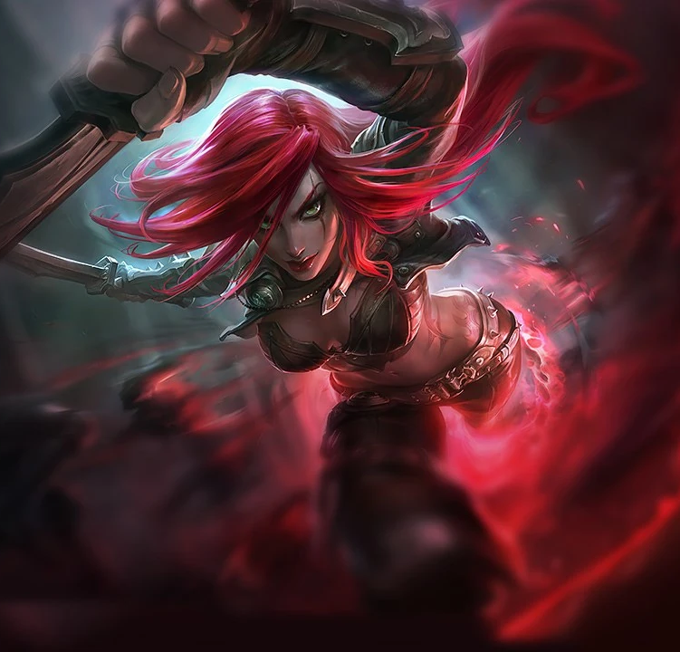


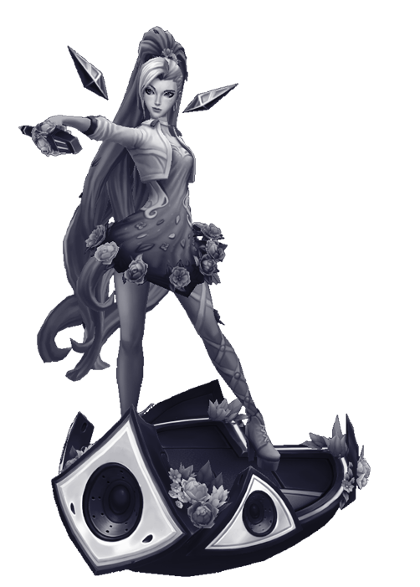

TEAM 1F: DISCORD ACCESSIBILITY
AN ALLY HAS BEEN SLAIN
what are you doing?
WELCOMING AND SUPPORTING UNDERREPRESENTED VOICES

Slide 6
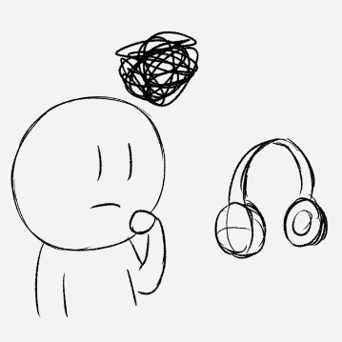
/THE PROBLEM
TEAM 1F: DISCORD ACCESSIBILITY
Communication platforms are not meeting the needs of hard-of-hearing (HOH) gamers
Poor accessibility features are causing feelings of isolation
WELCOMING AND SUPPORTING UNDERREPRESENTED VOICES

Slide 7
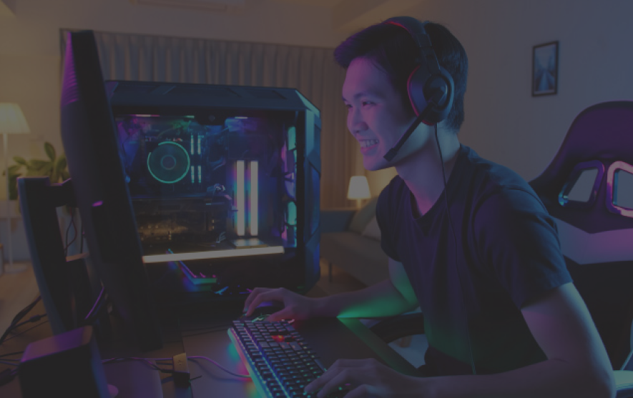
/HMW welcome and support HOH gamers in the communication platform Discord?
TEAM 1F: DISCORD ACCESSIBILITY
WELCOMING AND SUPPORTING UNDERREPRESENTED VOICES

Slide 8
/WHAT WE WANT TO ACHIEVE
/HOH GAMERS
/VOICE COMM DEVELOPERS
/GAME DEVELOPERS
TEAM 1F: DISCORD ACCESSIBILITY
Positive Gaming Experience
Support Their Users
Grow User Base
Grow Player Base
Retain Player Base
WELCOMING AND SUPPORTING UNDERREPRESENTED VOICES

Slide 9
/01
/DISCOVER
TEAM 1F: DISCORD ACCESSIBILITY
WELCOMING AND SUPPORTING UNDERREPRESENTED VOICES

Slide 10
/PRIMARY ANALYSIS
/01
/INTERACTION CONTROL
/02
/COMMUNITY
/03
/PERSONALIZATION
/04
/AWARENESS
YOUR LOGO HERE
Video games are quite demanding for interaction control
Community can foster positive experiences
Disability is unique, personalization is key
Encourage others to think about accessibility
INDEX.HTML

Slide 11
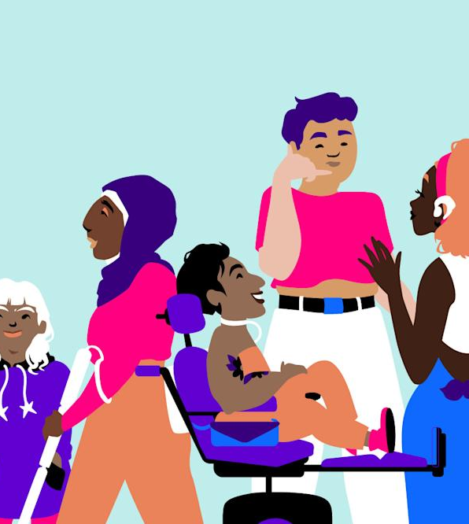
/ACCESSIBILITY AND AWARENESS
YOUR LOGO HERE
We knew we had to design something that would both foster positive, accessible experiences while also promoting accessibility awareness
INDEX.HTML

Slide 12
/02
<DEFINE>
TEAM 1F: DISCORD ACCESSIBILITY
WELCOMING AND SUPPORTING UNDERREPRESENTED VOICES
Notes:
Keeping that in mind, our next step was to define and understand our stakeholders needs

Slide 13
/OUR STAKEHOLDERS
/HOH GAMERS
/VOICE COMM DEVELOPERS
/GAME DEVELOPERS
TEAM 1F: DISCORD ACCESSIBILITY
Gamers who have difficulty hearing others
Developers of voice chat platforms
Developers of competitive games
WELCOMING AND SUPPORTING UNDERREPRESENTED VOICES
Notes:
Well, right off the bat we knew that our primary stakeholders were going to be HOH gamers followed by voice comm developers, particularly discord developers, and finally game developers since they are designing the games that utilize voice communication

Slide 14
/STAKEHOLDER NEEDS
/RESOURCES
/TOOLS
/EASY ACCESS
TEAM 1F: DISCORD ACCESSIBILITY
Needs a resource that provides tools for accessibility
Needs tools that will make communication experiences more effective
Needs the end product to be user friendly and easy to locate
WELCOMING AND SUPPORTING UNDERREPRESENTED VOICES
Notes:
Through semi-structured interviews with each of our defined stakeholders, we concluded that something that all of over stakeholders needed were resources and tools that were easy to use.

Slide 15
/03
<IDEATE>
TEAM 1F: DISCORD ACCESSIBILITY
WELCOMING AND SUPPORTING UNDERREPRESENTED VOICES
Notes:
Now that we understood our design space and stakeholder needs, it was time to start brainstorming.

Slide 16
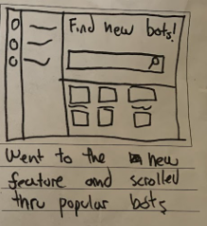
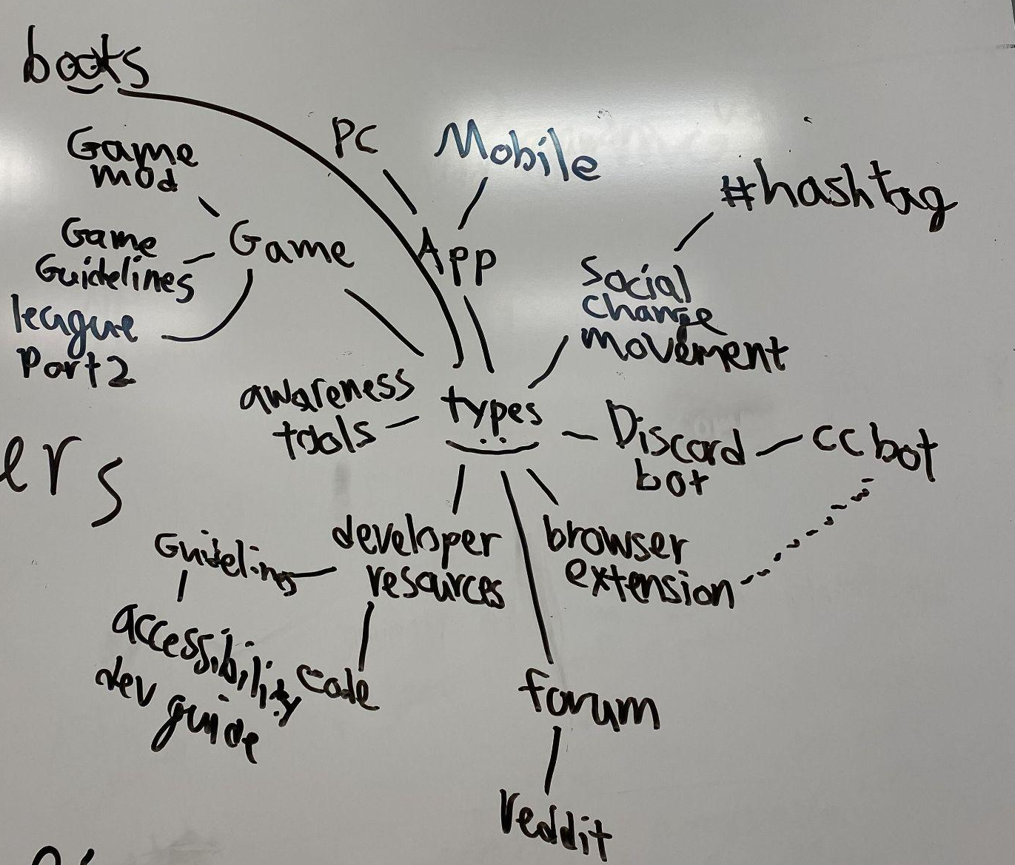
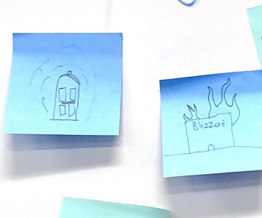
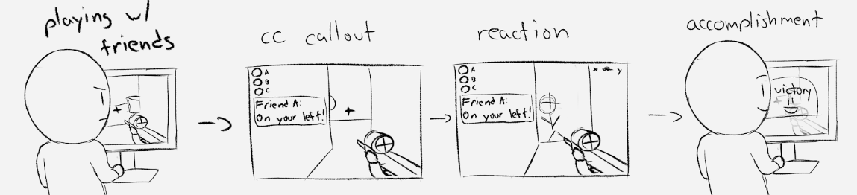
/BRAINSTORMING
TEAM 1F: DISCORD ACCESSIBILITY
WELCOMING AND SUPPORTING UNDERREPRESENTED VOICES
Notes:
For our initial brainstorms, our group did a ton of mind mapping, sketching, and storyboarding with different types of concept ideas that we had.

Slide 17
/CONCEPT IDEAS
/CC BOT
/BOT FINDER
/DEVELOPER GUIDE
TEAM 1F: DISCORD ACCESSIBILITY
Close Caption Voice Calls
Resource within Discord to find Bots
Accessibility Guidelines for Developers
WELCOMING AND SUPPORTING UNDERREPRESENTED VOICES
Notes:
After a couple of days of brainstorming, we came down to our final three concept ideas: - A discord bot that would close caption all voice call audio into a dedicated voice channel. - A bot finder feature embedded into Discord that would allow users find any type of bot theyre looking for, from accessibility bots to music bots! - And lastly, An accessibility guidelines resource for voice communication platform developers similar

Slide 18
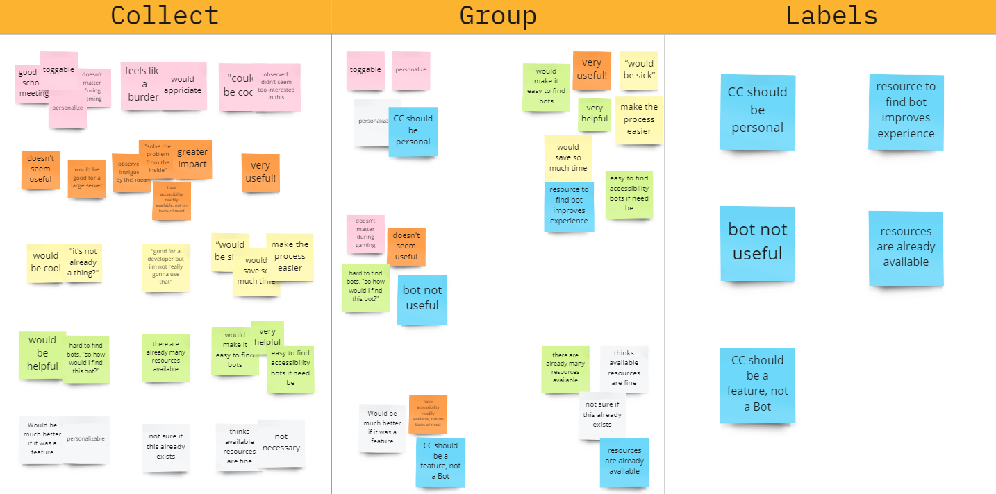
/CONCEPT TESTING & ANALYSIS
TEAM 1F: DISCORD ACCESSIBILITY
WELCOMING AND SUPPORTING UNDERREPRESENTED VOICES
Notes:
We conducted interviews with stakeholders to test our prototype concept and to get feedback on it.
We found that:

Slide 19

/DISCORD BOT
FINDER
YOUR LOGO HERE
INDEX.HTML

Slide 20
/04
/PROTOTYPE
TEAM 1F: DISCORD ACCESSIBILITY
WELCOMING AND SUPPORTING UNDERREPRESENTED VOICES
Notes:
After we fine tuned our concept idea, it was now time to prototype our bot finder!

Slide 21
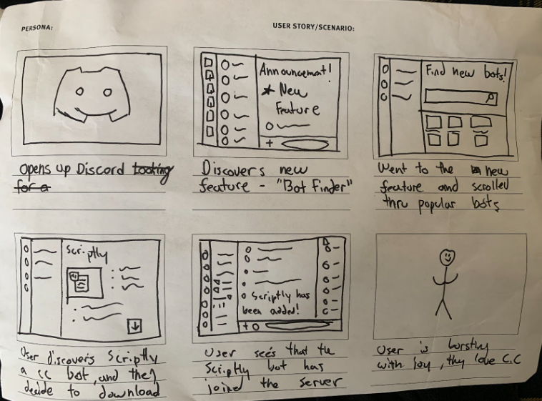
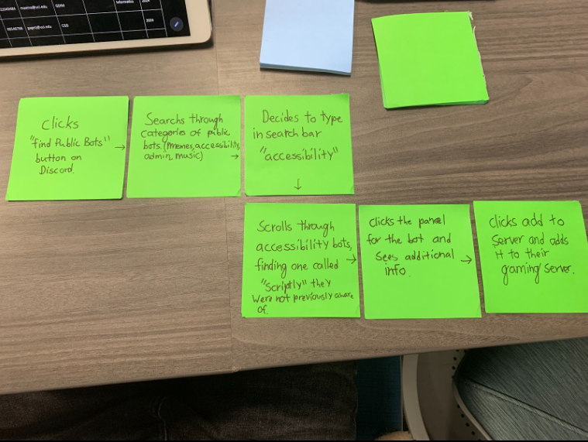
/STORYBOARD & USER FLOW
TEAM 1F: DISCORD ACCESSIBILITY
WELCOMING AND SUPPORTING UNDERREPRESENTED VOICES
Notes:
Before we started creating our prototype, we wrote out some storyboards and a general user flow for how we wanted our users to interact with and feel while using the bot finder

Slide 22

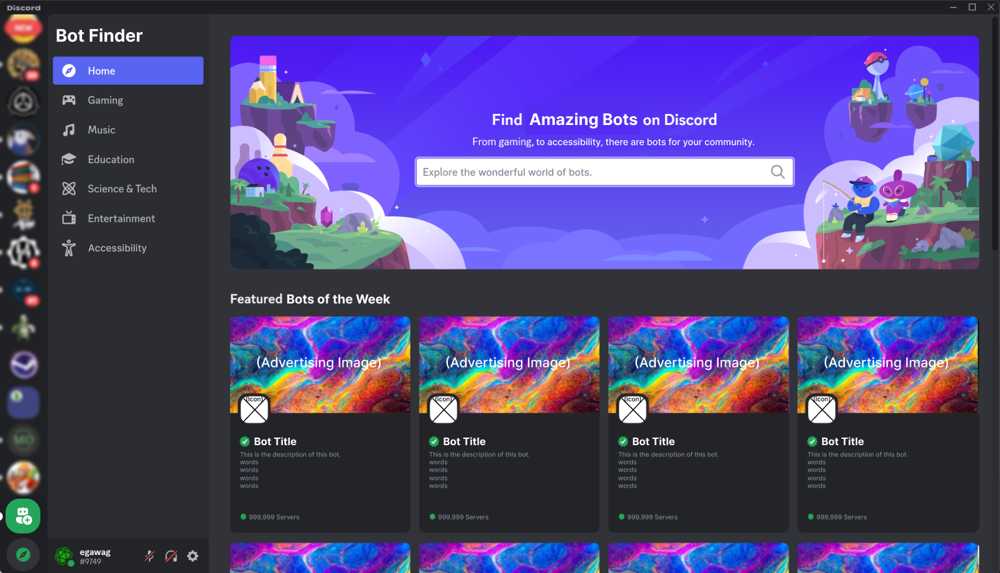
/OUR PROTOTYPE
TEAM 1F: DISCORD ACCESSIBILITY
WELCOMING AND SUPPORTING UNDERREPRESENTED VOICES
Notes:
Then, we created an interactive prototype of our bot finder using figma. Our inspiration for the design came from the already embedded server finder in discord. Users can search directly for the bot they want, our surf through one of the filter tabs we have on the left. After a user sees a bot they like, they can click on the bot and then easily add it to their server!

Slide 23

/DEMO
TEAM 1F: DISCORD ACCESSIBILITY
WELCOMING AND SUPPORTING UNDERREPRESENTED VOICES
Notes:
Here’s a quick demonstration of how the bot finder works.

Slide 24
/STAKEHOLDER FEEDBACK
/HOH GAMERS
/VOICE COMM DEVELOPERS
/GAME DEVELOPERS
TEAM 1F: DISCORD ACCESSIBILITY
“Wow, this makes it so much easier to find a bot if i wanted to.”
“This can foster a community around developing bots!It definitely needs more filter options, though”
“This makes finding bots so much easier, and saves so much time.”
WELCOMING AND SUPPORTING UNDERREPRESENTED VOICES
Notes:
After testing our prototype with our stakeholders, some of the feedback we received were that our prototype made it so much easier to find needed bots, and can also inspire a community for creating accessibility bots

Slide 25
/IMPACT OF BOT FINDER
/RESOURCE
/INCLUSIVITY
/AWARENESS
/COMMUNITY
TEAM 1F: DISCORD ACCESSIBILITY
Resource to find bots easily
Promotes inclusivity through accessibility bots
Raises disability awareness through exposure
Fosters community
WELCOMING AND SUPPORTING UNDERREPRESENTED VOICES

Slide 26
/OUR NEXT STEPS & QUESTIONS
/1
/SAFETY
/FILTERS
/2
/LOCATION
/3
/BEYOND HOH
/4
YOUR LOGO HERE
How do we ensure public bots are safe?
How do we implement a better filter system?
Bot Finder would be under the servers tab, causes confusion
Does bot finder support all types of users with disabilities?
INDEX.HTML

Slide 27
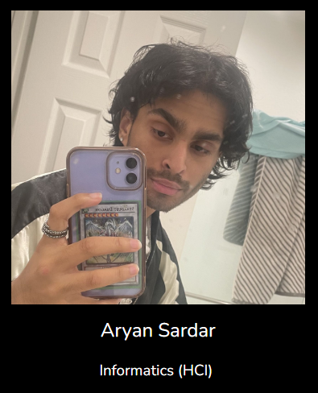
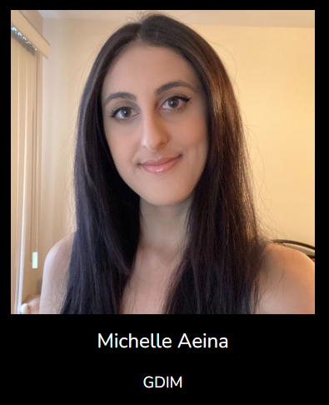
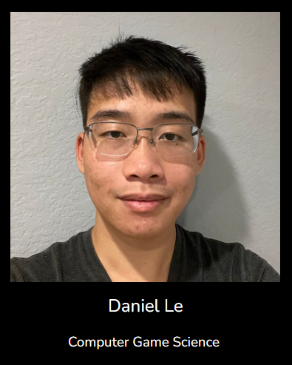
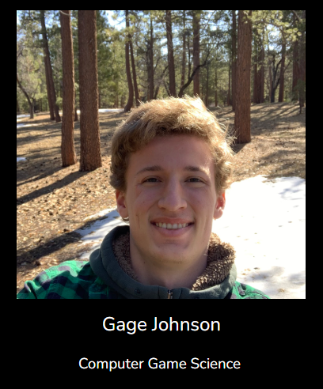
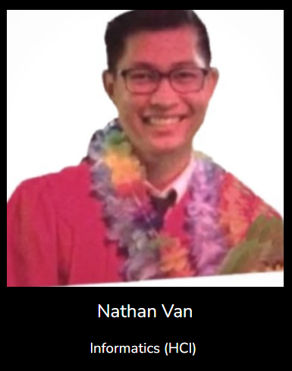
THANK YOU!
TEAM 1F: DISCORD ACCESSIBILITY
WELCOMING AND SUPPORTING UNDERREPRESENTED VOICES

